Slide 1
Fundamentals of CRE
Chemical Reaction Engineering
By
Dr Salah N. Farhan
Senior lecturer. Chem. Eng. Dept.
College of Engineering
University of Diyala
Salah N. Farhan College of Engineering Diyala University

Slide 2
Fundamentals of CRE
Chapter 5: Isothermal Reactor Design: Conversion
Learning Resources
Summary Notes
  Part 1: Mole Balances in Terms of Conversion
    Algorithm for Isothermal Reactor Design
    Applications/Examples of CRE Algorithm
    Reversible Reactions
    ODE (Polymath) Solutions to CRE Problems
    General Guidelines for California Problems
    PBR Reactors with Pressure Drop
    Engineering Analysis
  Analogy of CRE Algorithms to a Menu in a Fine French Restaurant
  Algorithm for Gas Phase Reaction
Salah N. Farhan College of Engineering Diyala University

Slide 3
Fundamentals of CRE
Topics
Algorithm for Isothermal Reactor Design
Applications/Examples of CRE Algorithm
Reversible Reactions
ODE (Polymath) Solutions to CRE Problems
General Guidelines for California Problems
PBR with Pressure Drop
Engineering Analysis
Salah N. Farhan College of Engineering Diyala University

Slide 4
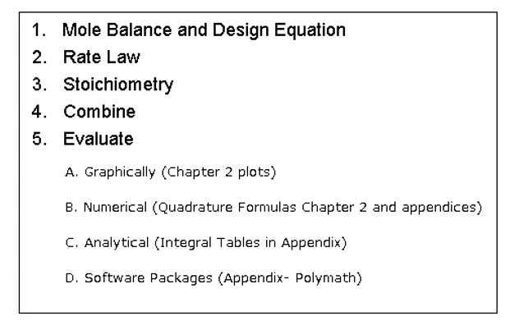
Fundamentals of CRE
Algorithm for Isothermal Reactor Design
Salah N. Farhan College of Engineering Diyala University

Slide 5
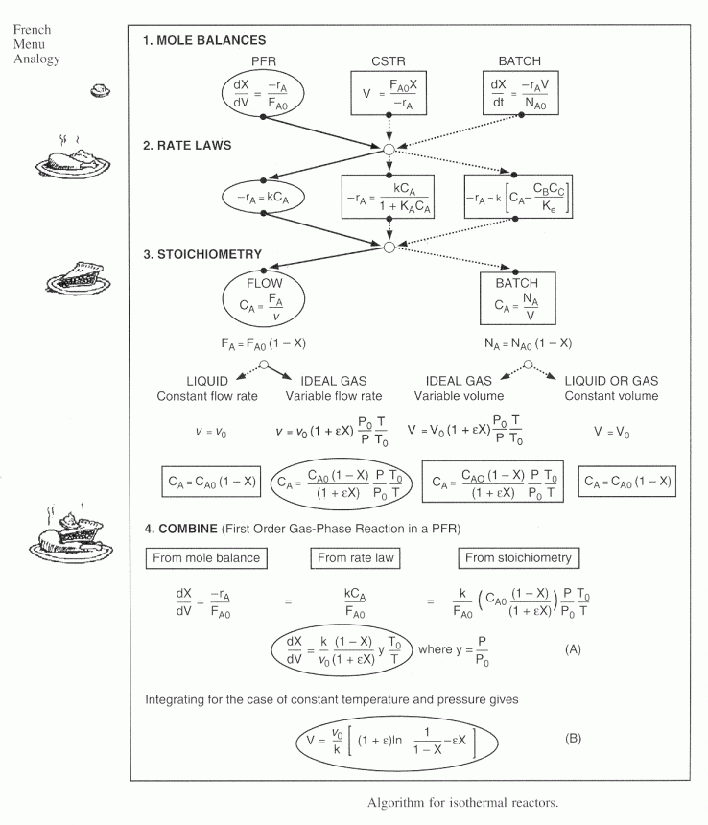
Fundamentals of CRE
Salah N. Farhan College of Engineering Diyala University

Slide 6
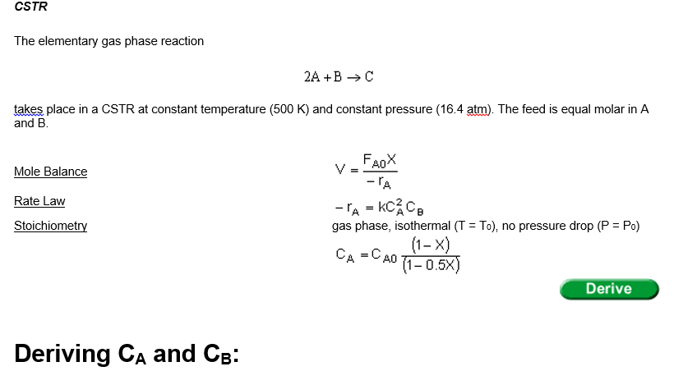
Fundamentals of CRE
Elementary gas phase reaction in different reactor types.
Salah N. Farhan College of Engineering Diyala University

Slide 7
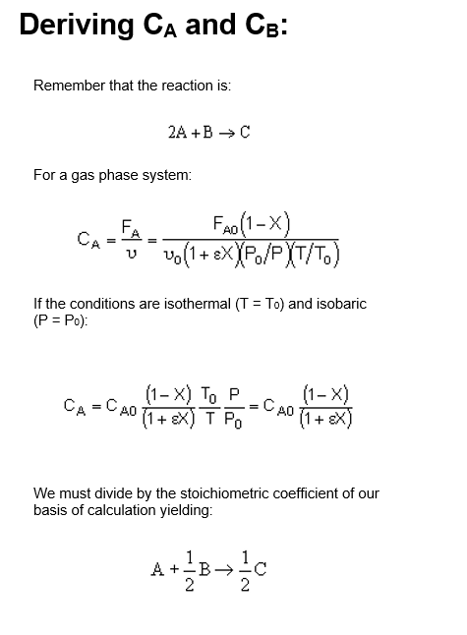
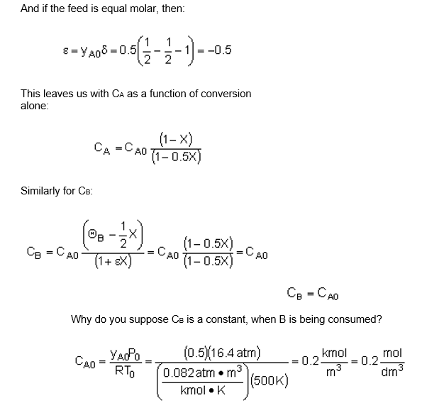
Fundamentals of CRE
Salah N. Farhan College of Engineering Diyala University

Slide 8
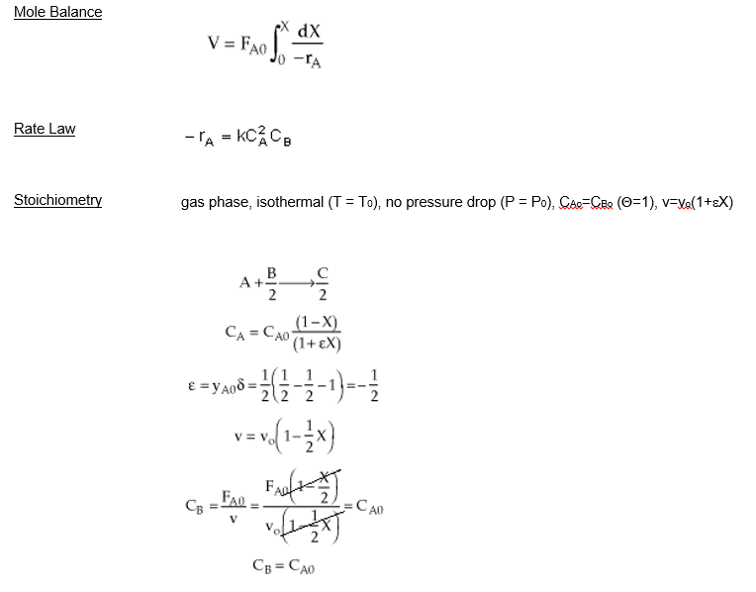
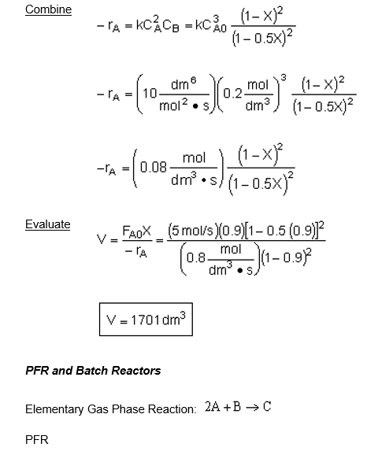
Fundamentals of CRE
Salah N. Farhan College of Engineering Diyala University

Slide 9
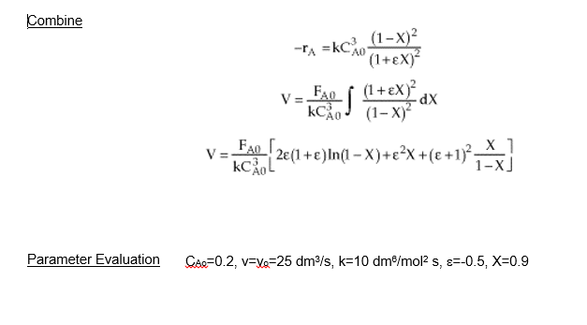
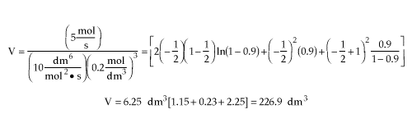
Fundamentals of CRE
V=227 dm³
Salah N. Farhan College of Engineering Diyala University

Slide 10
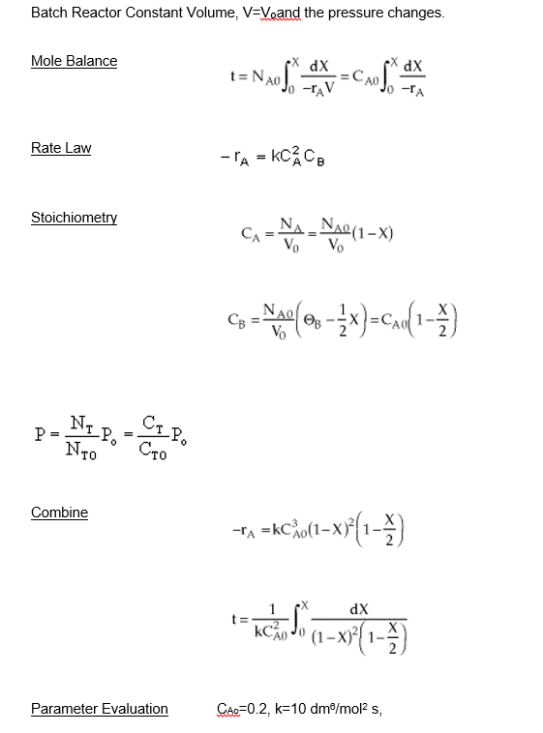
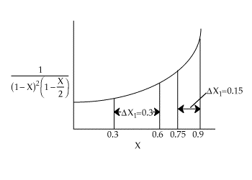

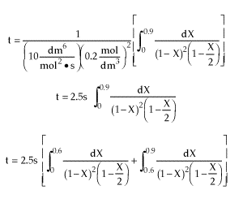
Fundamentals of CRE
Salah N. Farhan College of Engineering Diyala University

Slide 11
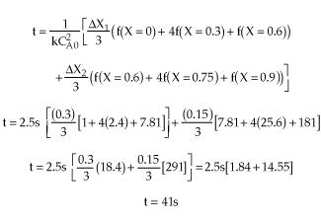
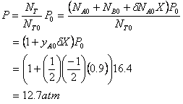
Fundamentals of CRE
Salah N. Farhan College of Engineering Diyala University

Slide 12
Fundamentals of CRE
Salah N. Farhan College of Engineering Diyala University

Slide 13
Fundamentals of CRE
Salah N. Farhan College of Engineering Diyala University

Slide 14
Fundamentals of CRE
Salah N. Farhan College of Engineering Diyala University

Slide 15
Fundamentals of CRE
Salah N. Farhan College of Engineering Diyala University

Slide 16
Fundamentals of CRE
Salah N. Farhan College of Engineering Diyala University

Slide 17
Fundamentals of CRE
Salah N. Farhan College of Engineering Diyala University

Slide 18
Fundamentals of CRE
Salah N. Farhan College of Engineering Diyala University

Slide 19
Fundamentals of CRE
Salah N. Farhan College of Engineering Diyala University

Slide 20
Fundamentals of CRE
Salah N. Farhan College of Engineering Diyala University

Slide 21
Fundamentals of CRE
Salah N. Farhan College of Engineering Diyala University

Slide 22
Fundamentals of CRE
Salah N. Farhan College of Engineering Diyala University

Slide 23
Fundamentals of CRE
Salah N. Farhan College of Engineering Diyala University

